Slide 1
INF1002 Programming Fundamentals (AY2025-T1)
Python – Lab5
10-Oct-2025

Slide 2
INF1002 – Programming Fundamentals
Warmup:
Lambda Expression
Map, filter, reduce
Not required to submit. Practice.
Lab5 Tasks:
5.1 Developing Do Twice Game
5.2 Developing Sales Analytics
Gradescope Submission due
Thursday, 16-Oct-2025 23:59:00

Slide 3

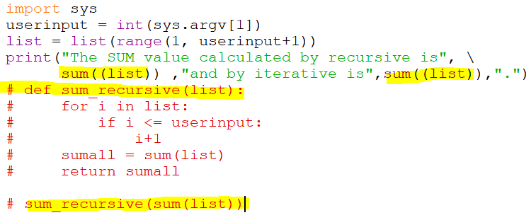

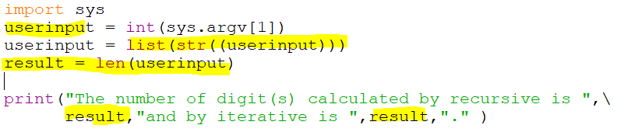



INF1002 – Programming Fundamentals
Feedback for Lab4 Tasks - Sum Calculator: Recursive? Iterative?
Syntax
Semantics
Recursive? Iterative? Learning outcome?
Ingenuity

Slide 4
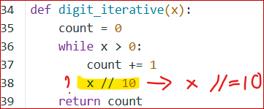
INF1002 – Programming Fundamentals
Feedback for Lab4 Tasks – Count Digits: endless loop

Slide 5
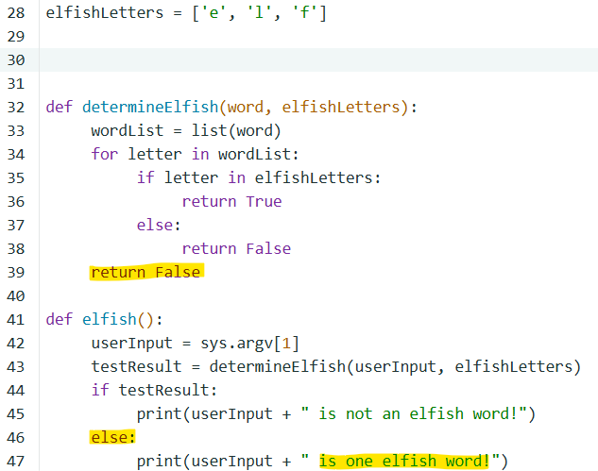
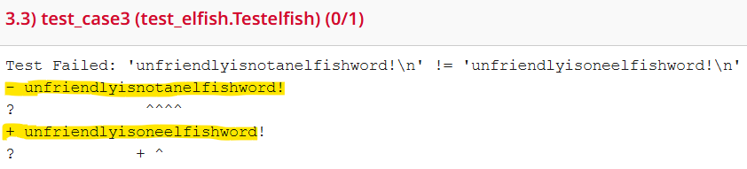
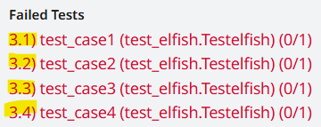
INF1002 – Programming Fundamentals
Feedback for Lab4 Tasks – “elfish”: Semantic error
Always False?

Slide 6
INF1002 – Programming Fundamentals
Feedback for Lab4 Tasks: Recursive functions
Recursive functions can be a powerful tool in programming, but they should be used judiciously.
Advantages:
Solving Recursive Problems:
Problems that are naturally recursive in nature.
Examples: Tree traversal, factorial calculation, and Fibonacci sequence generation.
Divide and Conquer Algorithms:
Examples: Binary search, quick sort, merge sort, Strassen's Matrix Multiplication
Readable Code:
Problems involving nested or hierarchical structures.
Examples: Flattening a Nested List, Binary Tree Traversal, XML/JSON Parsing, HTML Tree Traversal, Hierarchical database Queries
Simplifying Complex Logic:
To make the code more concise and easier to maintain, particularly for problems involving nested structures.
Disadvantages:
Large Input Sizes:
Large input size can lead to many function calls; each requiring memory on the call stack and may cause stack overflow error.
Performance Considerations:
Recursion may be less efficient in terms of execution time and memory usage. Recursion often involves function call overhead.
Readability and Maintainability:
Recursions can be harder to understand for some programmers.
Tail Recursion Optimization:
Some programming languages do not optimize tail-recursive functions, leading to stack overflow errors for large inputs.
Use recursive functions when they provide a clear and elegant solution to a problem, especially for cases involving recursive patterns and divide-and-conquer strategies.
Avoid if input size, performance, and code readability are to be factored.

Slide 7
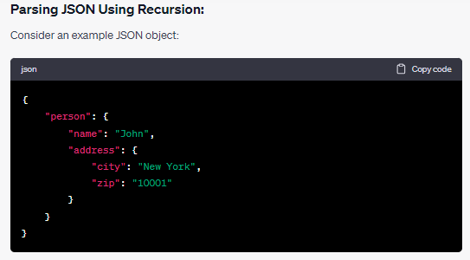
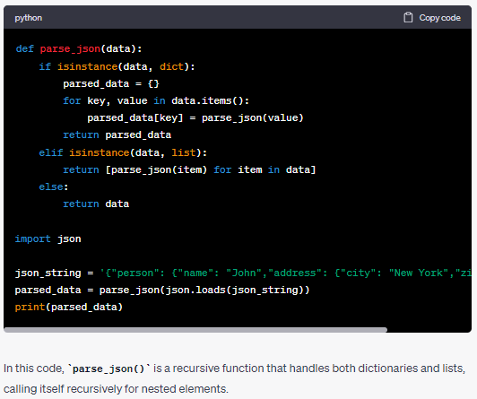
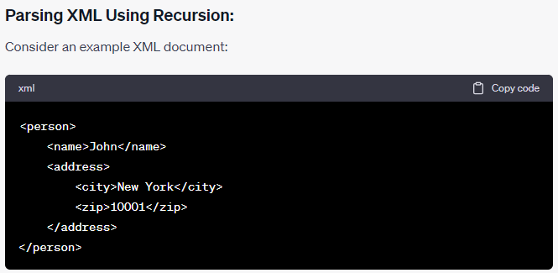
INF1002 – Programming Fundamentals
Feedback for Lab4 Tasks: Recursive functions
{'name': 'John', 'address': {'city': 'New York', 'zip': '10001'}}

Slide 8
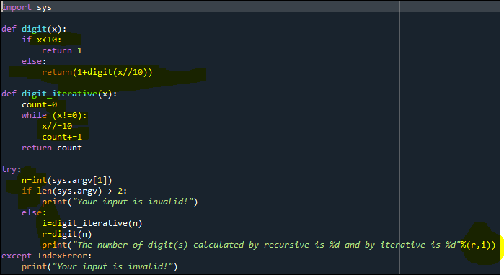
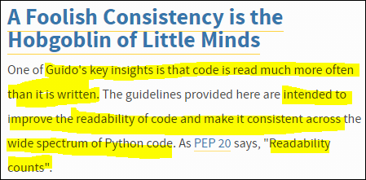
INF1002 – Programming Fundamentals
Feedback for Lab4 Tasks: Readability and consistency?
https://www.python.org/dev/peps/pep-0008/#whitespace-in-expressions-and-statements

Slide 9

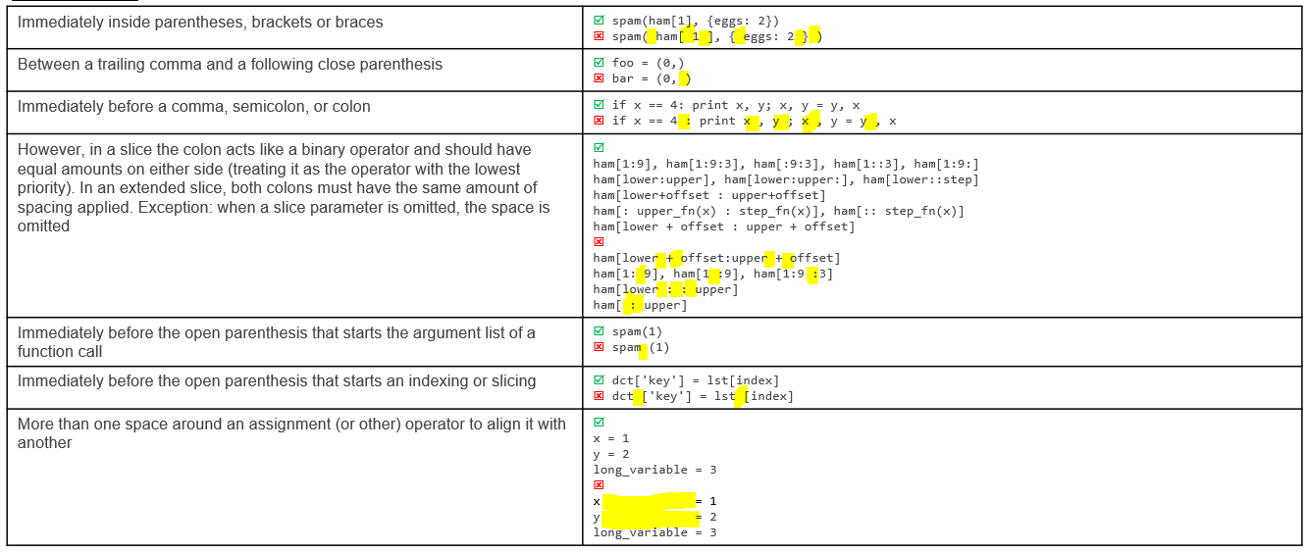
INF1002 – Programming Fundamentals
Feedback for Lab4 Tasks:
Avoid extraneous whitespace in the following situations:
https://www.python.org/dev/peps/pep-0008/#whitespace-in-expressions-and-statements

Slide 10
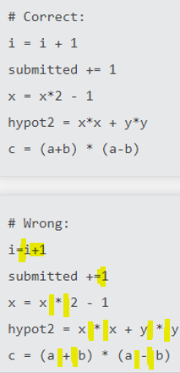

INF1002 – Programming Fundamentals
Feedback for Lab4 Tasks:
Avoid trailing whitespace anywhere. Because it's usually invisible, it can be confusing: e.g. a backslash followed by a space and a newline does not count as a line continuation marker.
Always surround these binary operators with a single space on either side: assignment (=), augmented assignment (+=, -= etc.), comparisons (==, <, >, !=, <>, <=, >=, in, not in, is, is not), Booleans (and, or, not).
If operators with different priorities are used, consider adding whitespace around the operators with the lowest priority(ies). Use your own judgment; however, never use more than one space, and always have the same amount of whitespace on both sides of a binary operator

Slide 11
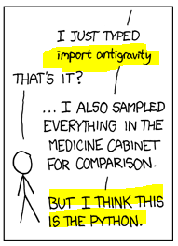

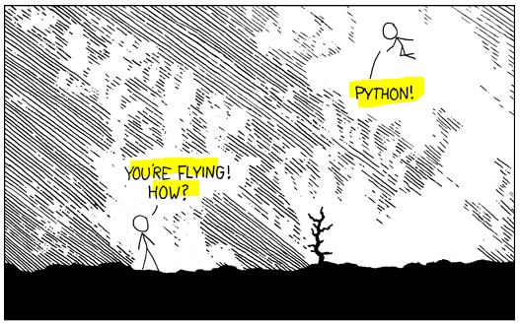
INF1002 – Programming Fundamentals
Feedback for Lab4 Tasks:
https://upjoke.com/python-jokes
What was a python’s first word?
https://xkcd.com/353/

Slide 12
INF1002 – Programming Fundamentals
For Gradescope issues, screen shot Gradescope “Autograder Results” page and email to: jacob.abraham@singaporetech.edu.sg

Slide 13
INF1002 – Programming Fundamentals
Python Lab Assignments
Week # | Python Lab # | Lab Date | Gradescope Release | Gradescope Due
2 | 1 | Friday, September 12, 2025 | Friday, September 12, 2025 08:00 | Thursday, September 18, 2025 23:59
3 | 2 | Friday, September 19, 2025 | Friday, September 19, 2025 08:00 | Thursday, September 25, 2025 23:59
4 | 3 | Friday, September 26, 2025 | Friday, September 26, 2025 08:00 | Thursday, October 2, 2025 23:59
5 | 4 | Friday, October 3, 2025 | Friday, October 3, 2025 08:00 | Thursday, October 9, 2025 23:59
6 | 5 | Friday, October 10, 2025 | Friday, October 10, 2025 08:00 | Thursday, October 16, 2025 23:59

